Slide 1




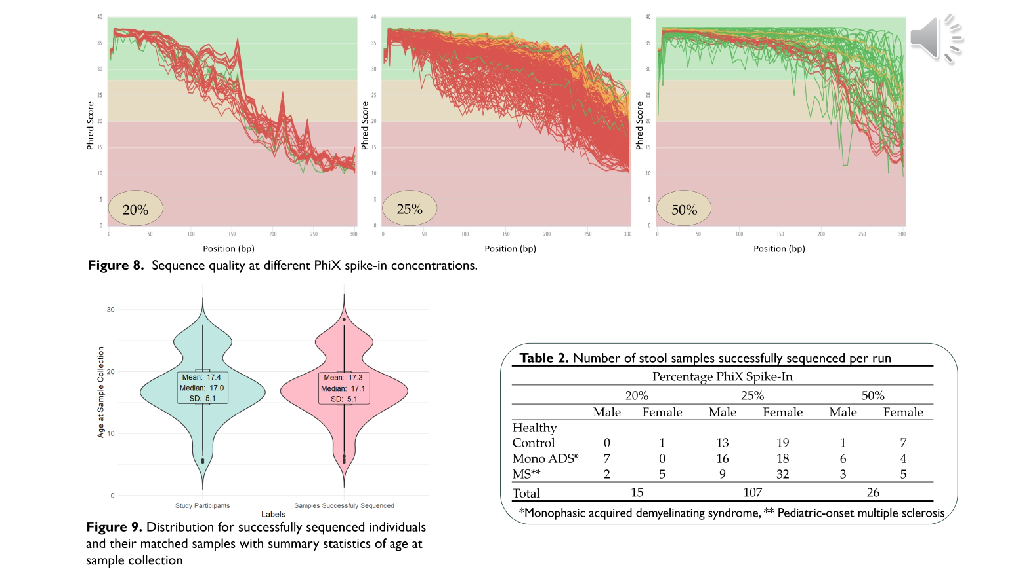
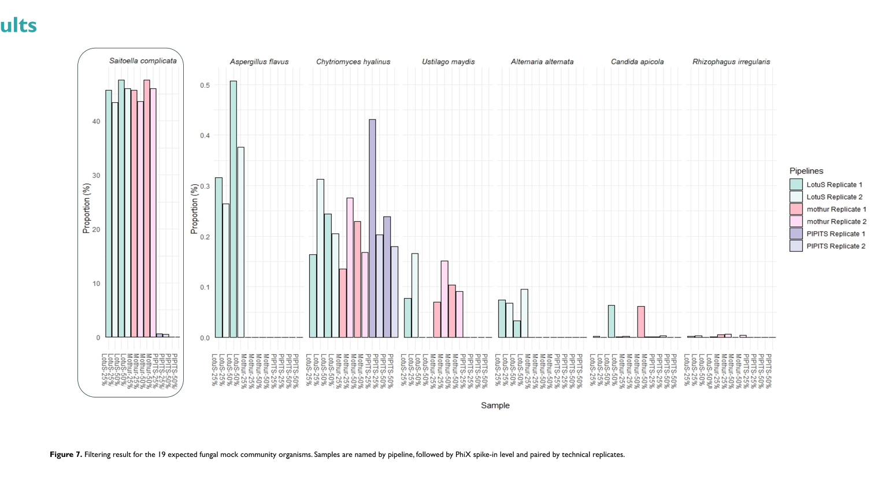
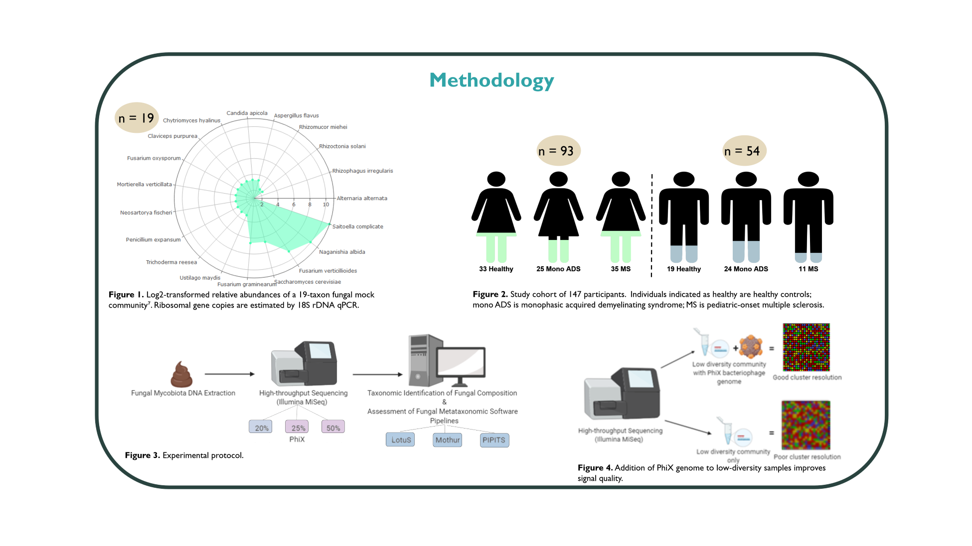
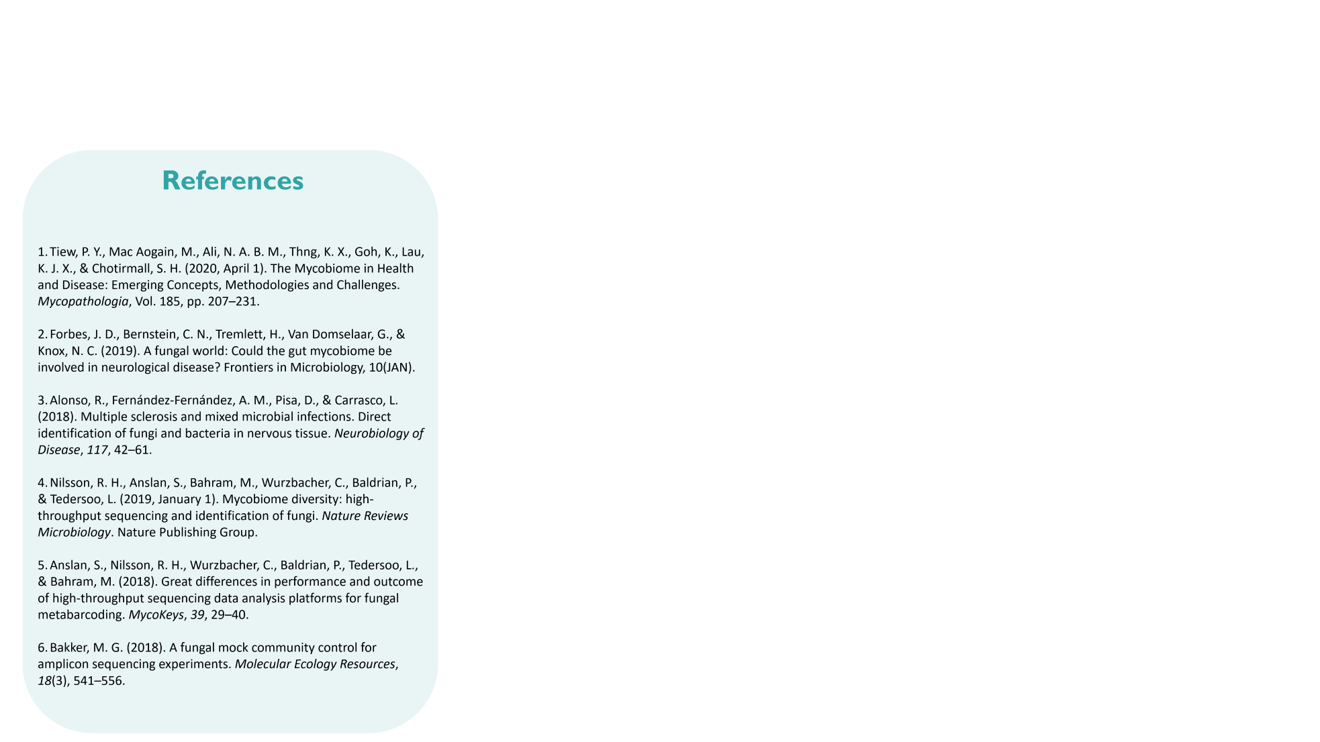
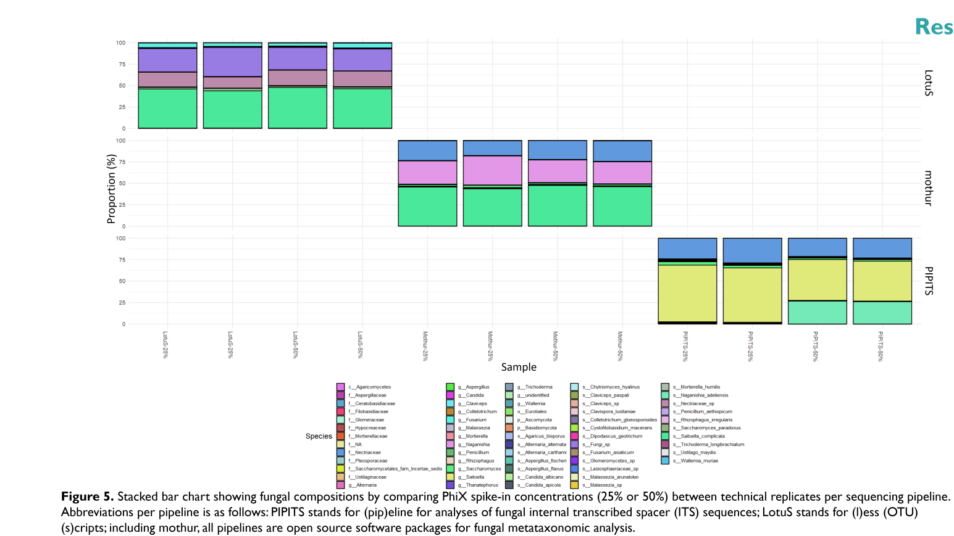
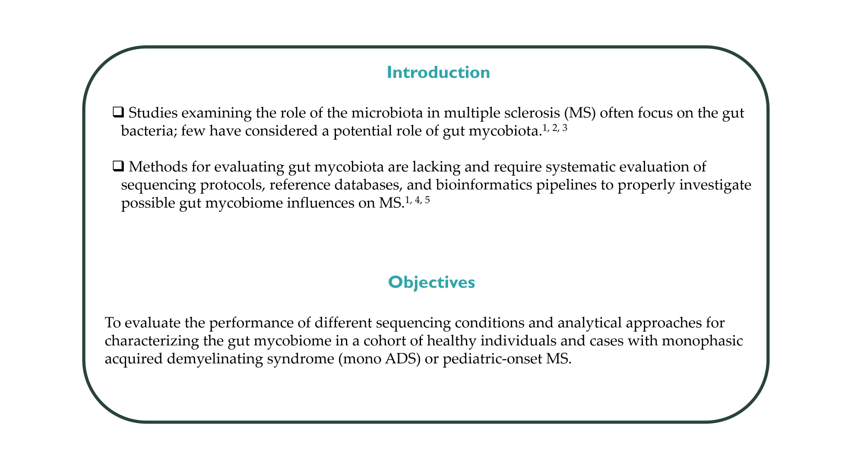
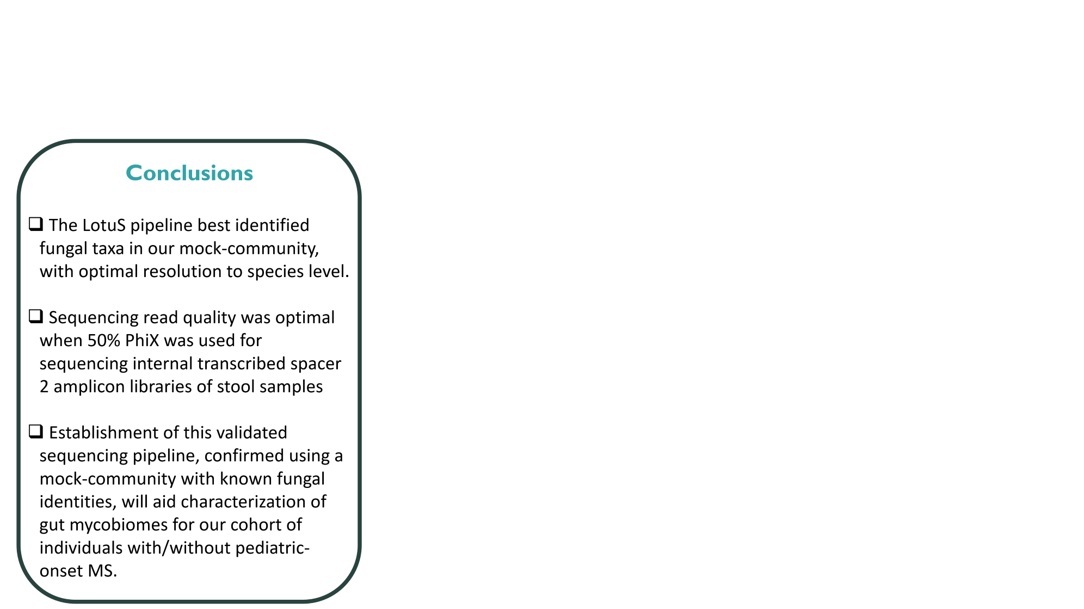
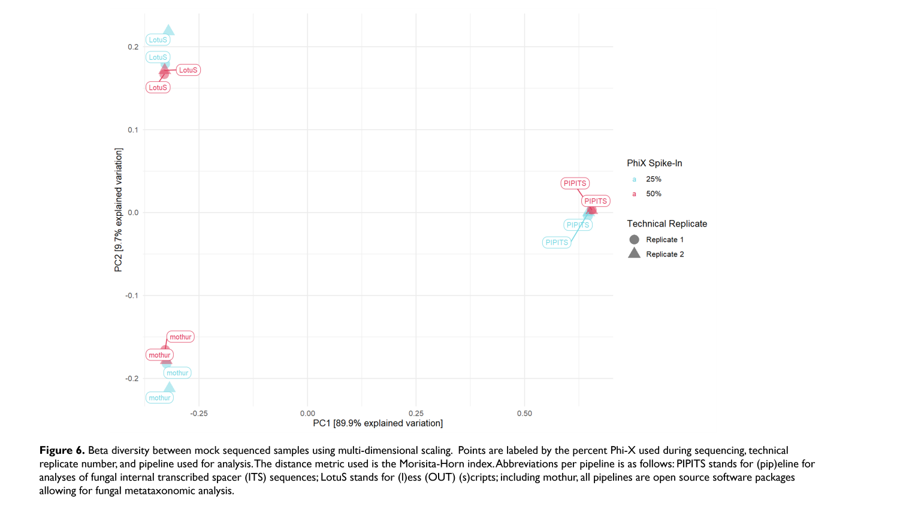

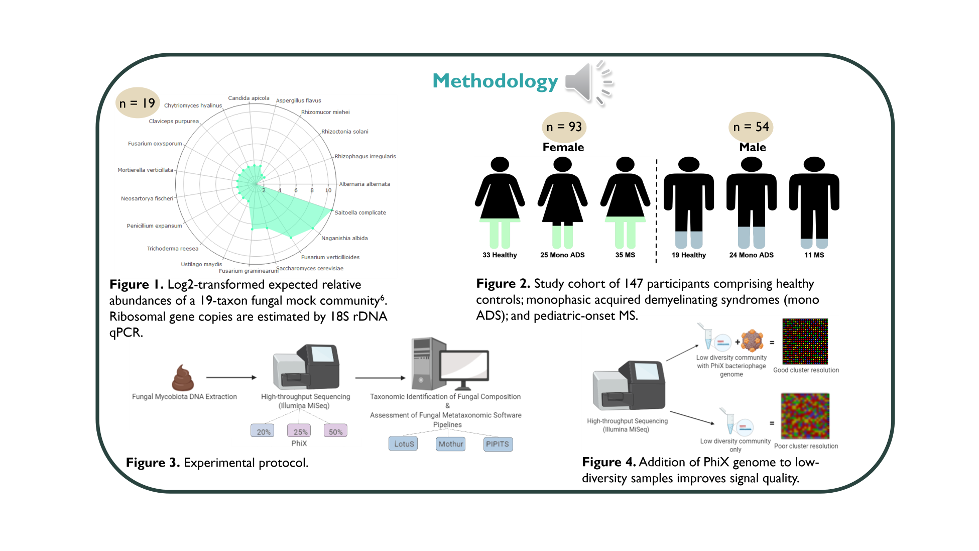
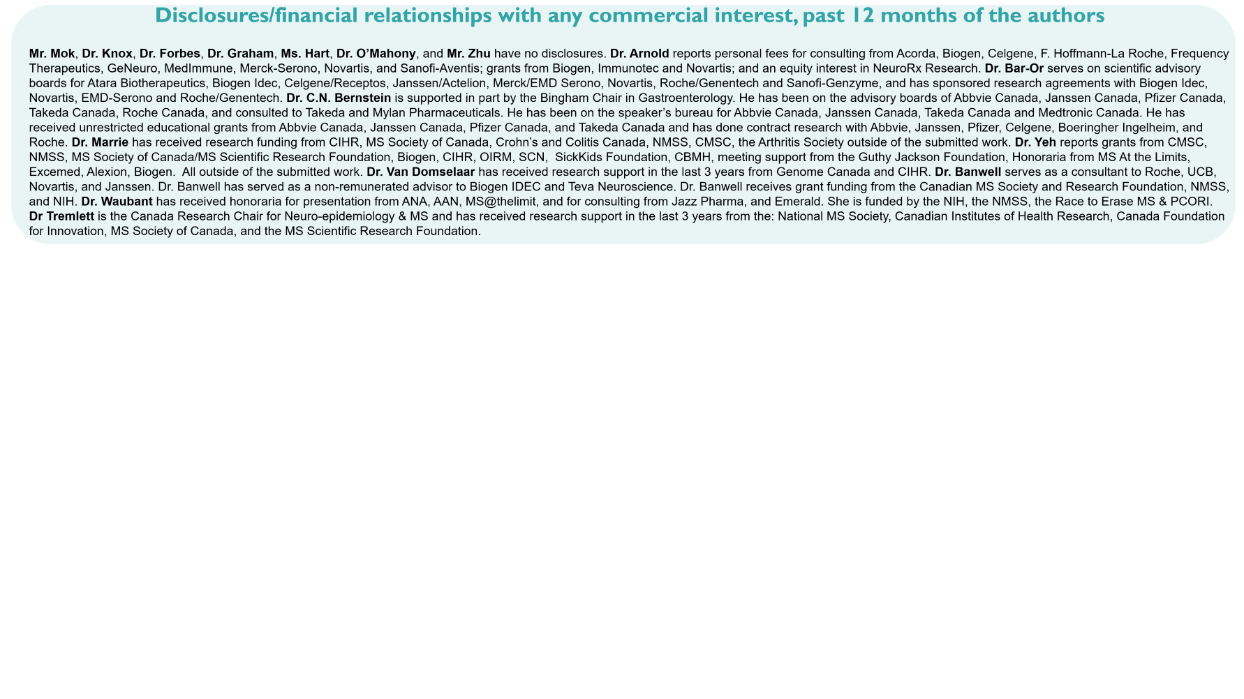
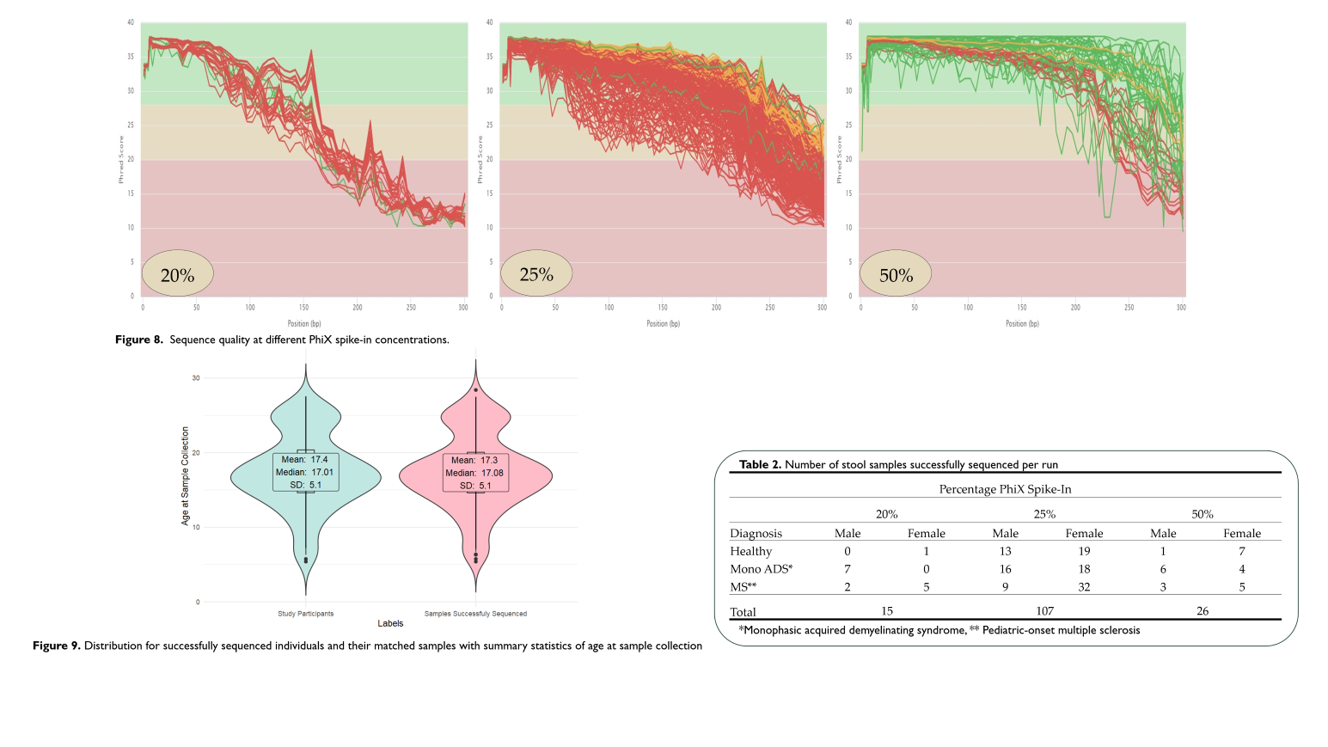
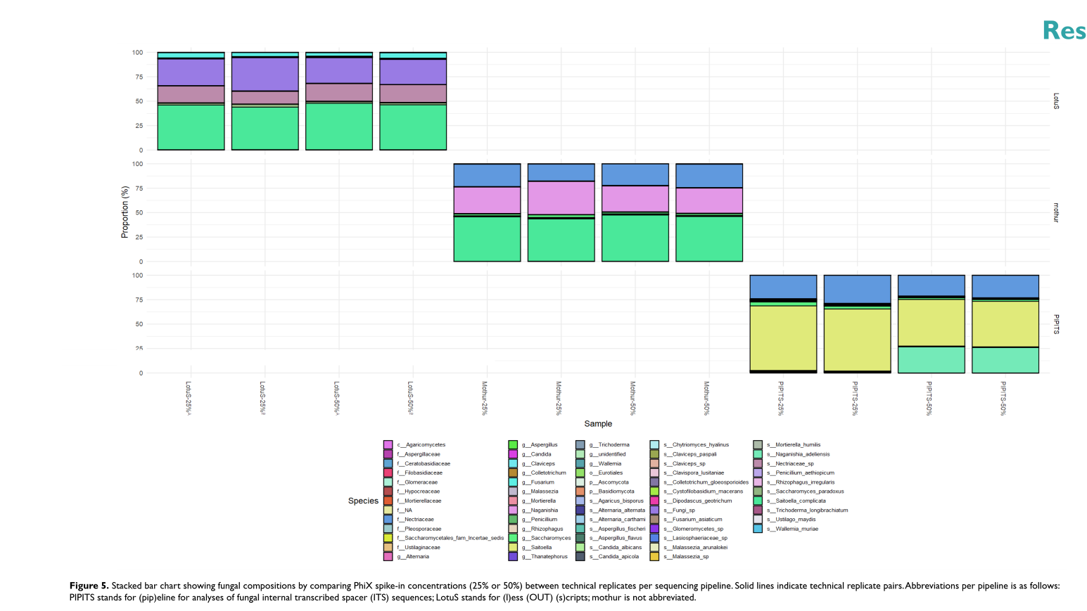
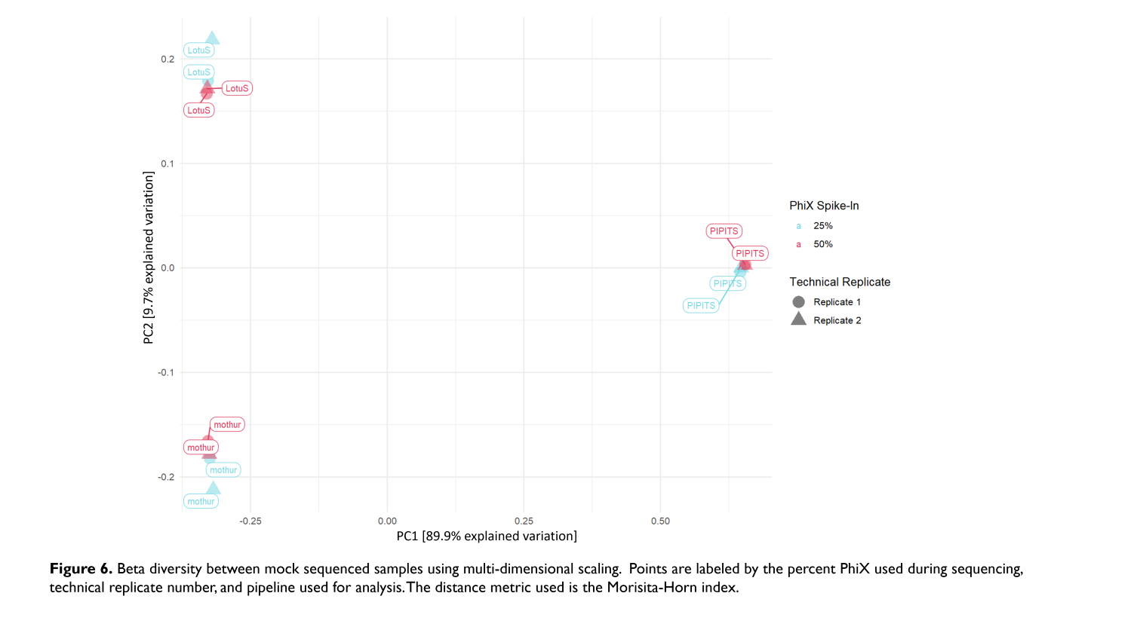
The gut mycobiome in pediatric multiple sclerosis:
Establishing a bioinformatics pipeline
N. Mok¹, N. Knox², D.L. Arnold³, A. Bar-Or⁴, C.N. Bernstein¹, J. Forbes⁵, M. Graham², J. Hart⁶, R.A. Marrie¹, J. O’mahony⁷, E.A. Yeh⁵, F. Zhu⁸, G. Van Domselaar², B. Banwell⁹,
E. Waubant⁶, H. Tremlett⁸;
¹University of Manitoba, MB/Canada, ²Public Health Agency of Canada, MB/Canada, ³McGill University, QC/Canada, ⁴University of Pennsylvania, PA/United States of America, ⁵University of Toronto, ON/Canada,
⁶University of California San Francisco, CA/United States of America, ⁷The Hospital for Sick Children, ON/Canada, ⁸University of British Columbia, BC/Canada, ⁹Children’s Hospital of Philadelphia, PA/United States of America
Email: mokn@myumanitoba.ca
Notes:
Start (title) 5sec|disclosures ~5sec|intro+obj 15sec|methods (audio 104.99sec)|fig 5 ~20sec|fig 6 ~20sec|fig 7 (audio 28.86sec)+15sec|fig 8 (audio 44.25sec)+15sec|concl. 15sec|ref 5sec|end 5sec
Total audio = 104.99+28.86+44.25= 178.1sec or 2.97min
Total slide time = 298.1sec or 4.97min

Slide 2
Disclosures/financial relationships with any commercial interest, past 12 months of the authors
Mr. Mok, Dr. Knox, Dr. Forbes, Dr. Graham, Ms. Hart, Dr. O’Mahony, and Mr. Zhu have no disclosures. Dr. Arnold reports personal fees for consulting from Acorda, Biogen, Celgene, F. Hoffmann-La Roche, Frequency Therapeutics, GeNeuro, MedImmune, Merck-Serono, Novartis, and Sanofi-Aventis; grants from Biogen, Immunotec and Novartis; and an equity interest in NeuroRx Research. Dr. Bar-Or serves on scientific advisory boards for Atara Biotherapeutics, Biogen Idec, Celgene/Receptos, Janssen/Actelion, Merck/EMD Serono, Novartis, Roche/Genentech and Sanofi-Genzyme, and has sponsored research agreements with Biogen Idec, Novartis, EMD-Serono and Roche/Genentech. Dr. C.N. Bernstein is supported in part by the Bingham Chair in Gastroenterology. He has been on the advisory boards of Abbvie Canada, Janssen Canada, Pfizer Canada, Takeda Canada, Roche Canada, and consulted to Takeda and Mylan Pharmaceuticals. He has been on the speaker’s bureau for Abbvie Canada, Janssen Canada, Takeda Canada and Medtronic Canada. He has received unrestricted educational grants from Abbvie Canada, Janssen Canada, Pfizer Canada, and Takeda Canada and has done contract research with Abbvie, Janssen, Pfizer, Celgene, Boeringher Ingelheim, and Roche. Dr. Marrie has received research funding from CIHR, MS Society of Canada, Crohn’s and Colitis Canada, NMSS, CMSC, the Arthritis Society outside of the submitted work. Dr. Yeh reports grants from CMSC, NMSS, MS Society of Canada/MS Scientific Research Foundation, Biogen, CIHR, OIRM, SCN, SickKids Foundation, CBMH, meeting support from the Guthy Jackson Foundation, Honoraria from MS At the Limits, Excemed, Alexion, Biogen. All outside of the submitted work. Dr. Van Domselaar has received research support in the last 3 years from Genome Canada and CIHR. Dr. Banwell serves as a consultant to Roche, UCB, Novartis, and Janssen. Dr. Banwell has served as a non-remunerated advisor to Biogen IDEC and Teva Neuroscience. Dr. Banwell receives grant funding from the Canadian MS Society and Research Foundation, NMSS, and NIH. Dr. Waubant has received honoraria for presentation from ANA, AAN, MS@thelimit, and for consulting from Jazz Pharma, and Emerald. She is funded by the NIH, the NMSS, the Race to Erase MS & PCORI.
Dr Tremlett is the Canada Research Chair for Neuro-epidemiology & MS and has received research support in the last 3 years from the: National MS Society, Canadian Institutes of Health Research, Canada Foundation for Innovation, MS Society of Canada, and the MS Scientific Research Foundation.

Slide 3
Introduction
Studies examining the role of the microbiota in multiple sclerosis (MS) often focus on the gut bacteria; few have considered a potential role of gut mycobiota.^{1, 2, 3}
Methods for evaluating gut mycobiota are lacking and require systematic evaluation of sequencing protocols, reference databases, and bioinformatics pipelines to properly investigate possible gut mycobiome influences on MS.^{1, 4, 5}
Objectives
To evaluate the performance of different sequencing conditions and analytical approaches for characterizing the gut mycobiome in a cohort of healthy individuals and cases with monophasic acquired demyelinating syndrome (mono ADS) or pediatric-onset MS.

Slide 4

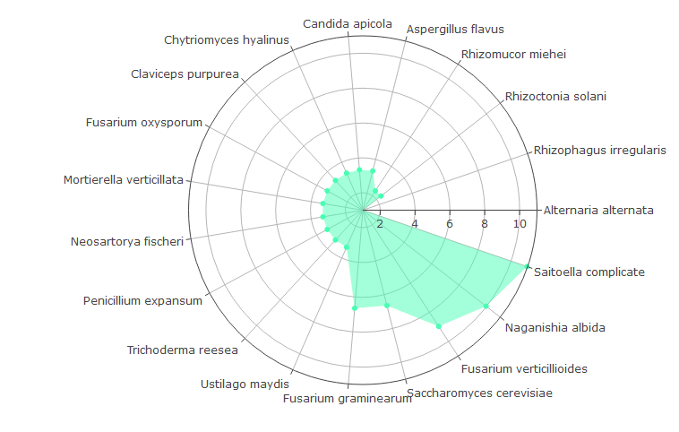
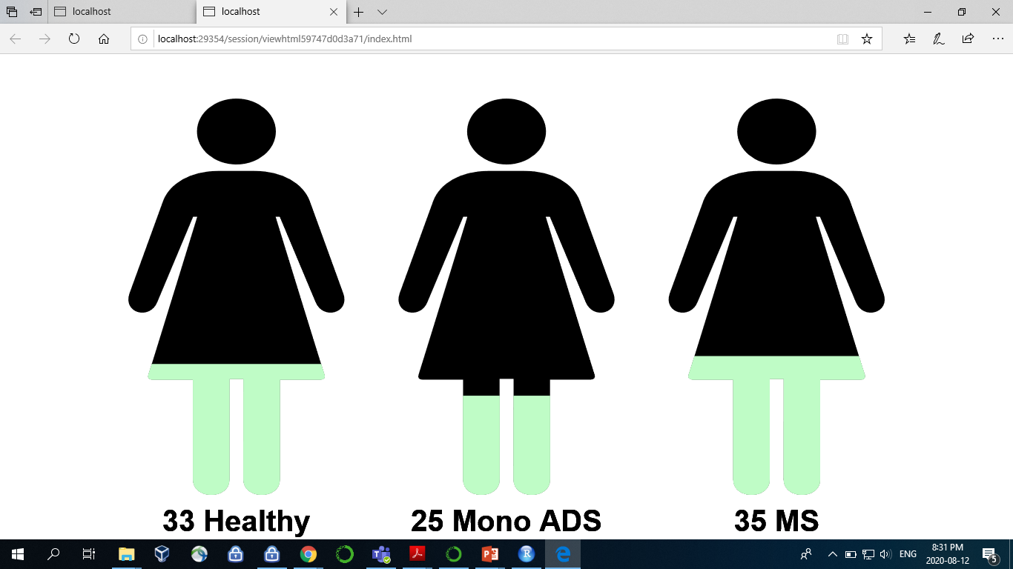
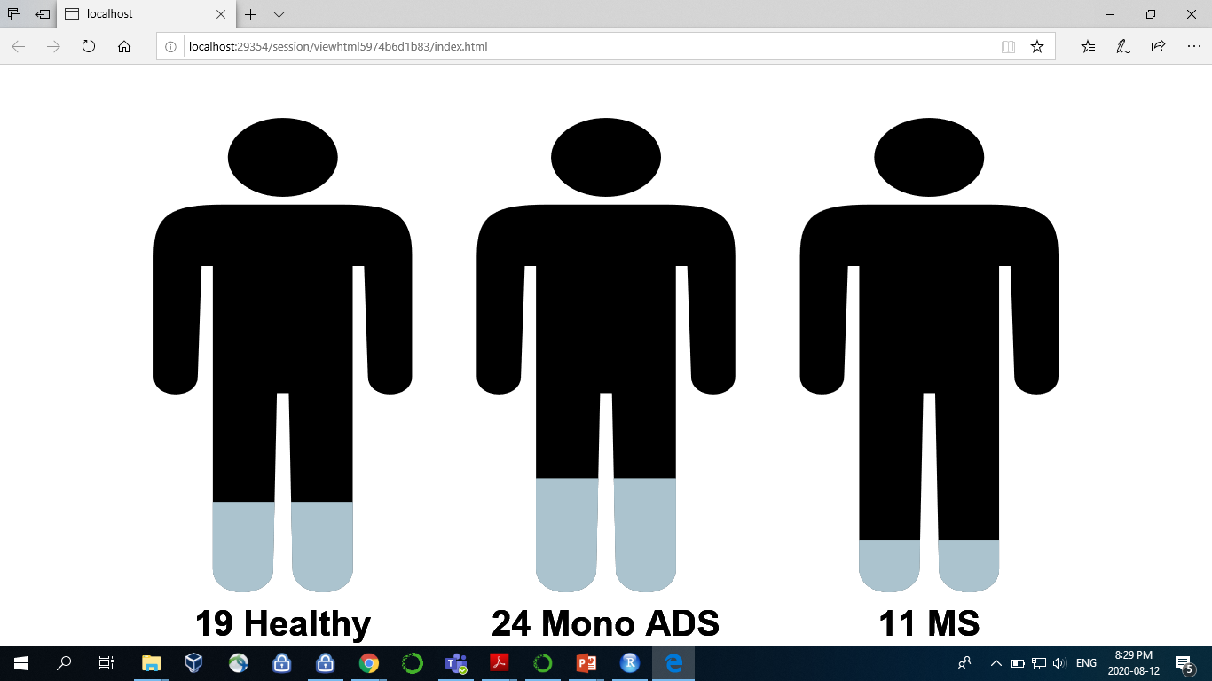
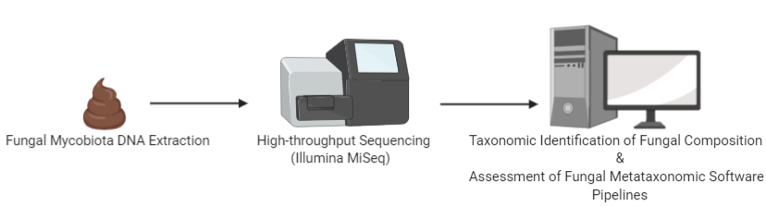
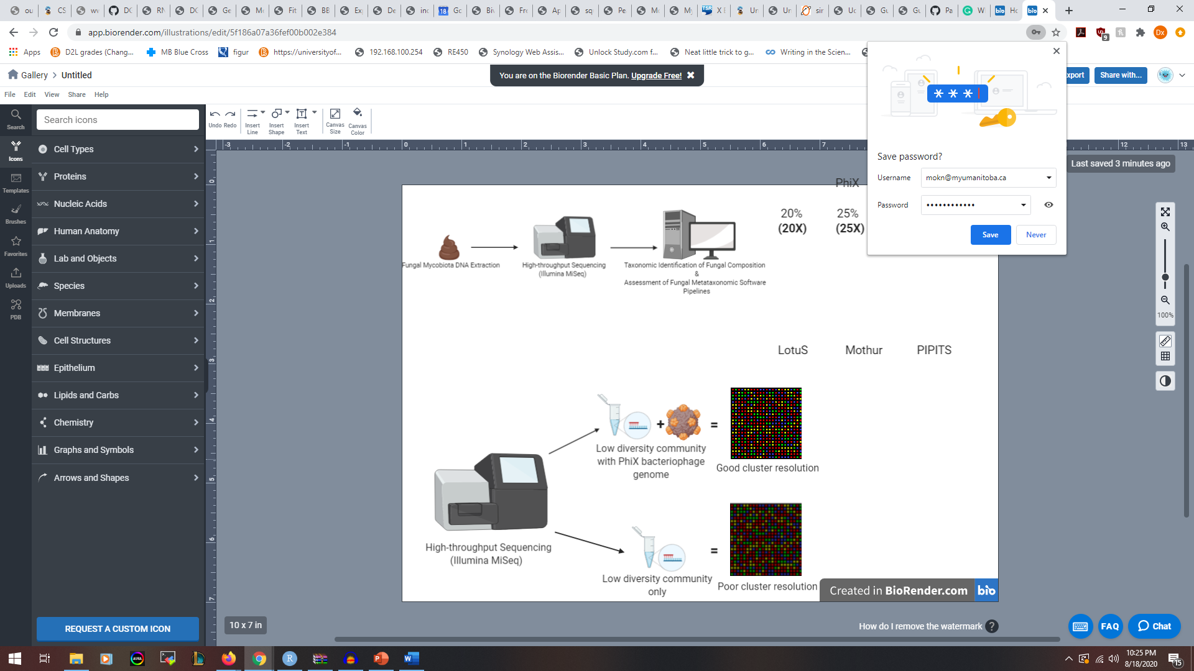
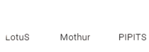
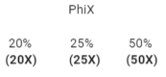
Methodology
n = 19
n = 93
n = 54
Female
Male
Figure 1. Log2-transformed expected relative abundances of a 19-taxon fungal mock community⁶. Ribosomal gene copies are estimated by 18S rDNA qPCR.
Figure 2. Study cohort of 147 participants comprising healthy controls; monophasic acquired demyelinating syndromes (mono ADS); and pediatric-onset MS.
Figure 3. Experimental protocol.
Figure 4. Addition of PhiX genome to low-diversity samples improves signal quality.

Slide 5
Results
LotuS
Proportion (%)
mothur
PIPITS
Sample
Figure 5. Stacked bar chart showing fungal compositions by comparing PhiX spike-in concentrations (25% or 50%) between technical replicates per sequencing pipeline. Abbreviations per pipeline is as follows: PIPITS stands for (pip)eline for analyses of fungal internal transcribed spacer (ITS) sequences; LotuS stands for (l)ess (OTU) (s)cripts; including mothur, all pipelines are open source software packages for fungal metataxonomic analysis.

Slide 6
PC2 [9.7% explained variation]
PC1 [89.9% explained variation]
Figure 6. Beta diversity between mock sequenced samples using multi-dimensional scaling. Points are labeled by the percent PhiX used during sequencing, technical replicate number, and pipeline used for analysis. The distance metric used is the Morisita-Horn index.

Slide 7
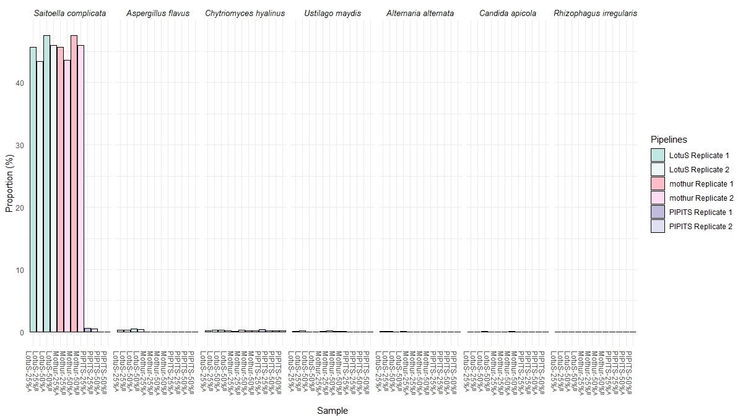
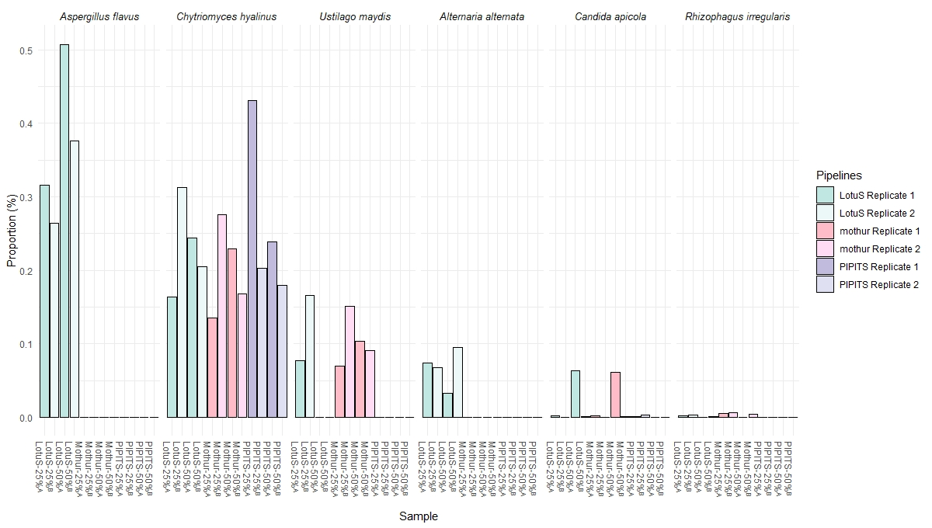
Results
Proportion (%)
Sample
Figure 7. Filtering result for the 19 expected fungal mock community organisms. Samples are named by pipeline, followed by PhiX spike-in level and paired by technical replicates.

Slide 8
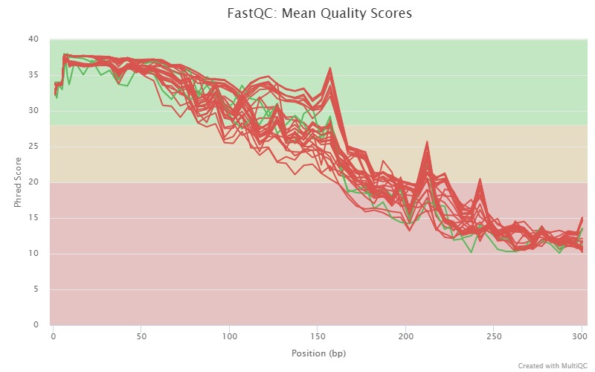
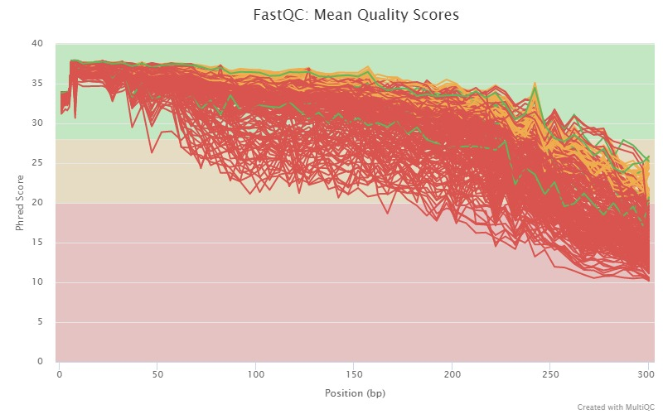
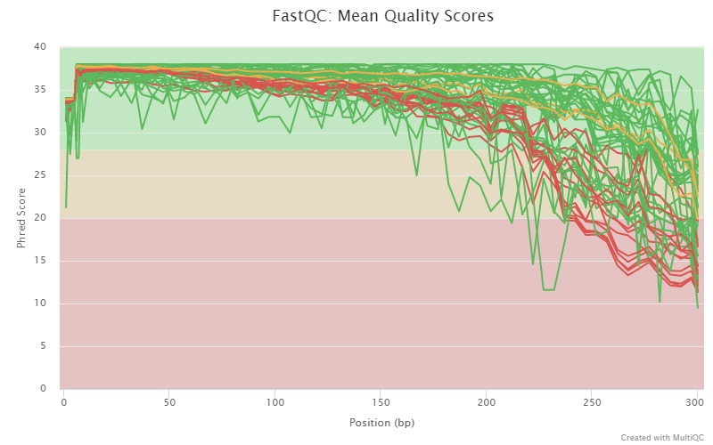
Phred Score
Phred Score
Phred Score
20%
25%
50%
Position (bp)
Position (bp)
Position (bp)
Figure 8. Sequence quality at different PhiX spike-in concentrations.
Table 2. Number of stool samples successfully sequenced per run
Percentage PhiX Spike-In
 | 20% |  | 25% |  | 50%
 | Male | Female | Male | Female | Male | Female
Healthy Control | 0 | 1 | 13 | 19 | 1 | 7
Mono ADS* | 7 | 0 | 16 | 18 | 6 | 4
MS** | 2 | 5 | 9 | 32 | 3 | 5
Total | 15 |  | 107 |  | 26
*Monophasic acquired demyelinating syndrome, ** Pediatric-onset multiple sclerosis
Figure 9. Distribution for successfully sequenced individuals and their matched samples with summary statistics of age at sample collection

Slide 9
Conclusions
The LotuS pipeline best identified fungal taxa in our mock-community, with optimal resolution to species level.
Sequencing read quality was optimal when 50% PhiX was used for sequencing internal transcribed spacer 2 amplicon libraries of stool samples
Establishment of this validated sequencing pipeline, confirmed using a mock-community with known fungal identities, will aid characterization of gut mycobiomes for our cohort of individuals with/without pediatric-onset MS.

Slide 10
References
Tiew, P. Y., Mac Aogain, M., Ali, N. A. B. M., Thng, K. X., Goh, K., Lau, K. J. X., & Chotirmall, S. H. (2020, April 1). The Mycobiome in Health and Disease: Emerging Concepts, Methodologies and Challenges. Mycopathologia, Vol. 185, pp. 207–231.
Forbes, J. D., Bernstein, C. N., Tremlett, H., Van Domselaar, G., & Knox, N. C. (2019). A fungal world: Could the gut mycobiome be involved in neurological disease? Frontiers in Microbiology, 10(JAN).
Alonso, R., Fernández-Fernández, A. M., Pisa, D., & Carrasco, L. (2018). Multiple sclerosis and mixed microbial infections. Direct identification of fungi and bacteria in nervous tissue. Neurobiology of Disease, 117, 42–61.
Nilsson, R. H., Anslan, S., Bahram, M., Wurzbacher, C., Baldrian, P., & Tedersoo, L. (2019, January 1). Mycobiome diversity: high-throughput sequencing and identification of fungi. Nature Reviews Microbiology. Nature Publishing Group.
Anslan, S., Nilsson, R. H., Wurzbacher, C., Baldrian, P., Tedersoo, L., & Bahram, M. (2018). Great differences in performance and outcome of high-throughput sequencing data analysis platforms for fungal metabarcoding. MycoKeys, 39, 29–40.
Bakker, M. G. (2018). A fungal mock community control for amplicon sequencing experiments. Molecular Ecology Resources, 18(3), 541–556.

